Slide 1
12.06.2024
Principles of Autonomy and Decision Making
Md Shiful Islam

Slide 2
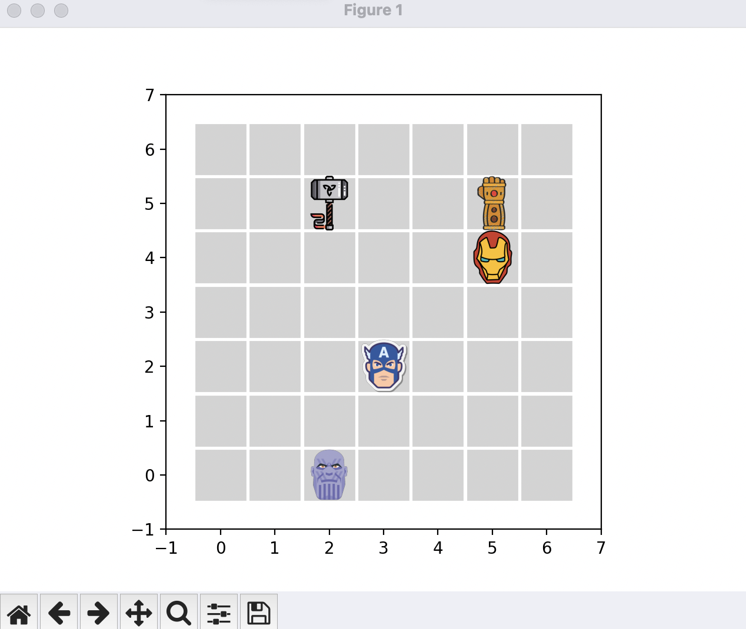
A Custom Gymnasium Environment
Environment Overview
7x7 grid-based environment
Main character: Thanos, starting at position (1, 1)
Goal: Reach the Infinity Gauntlet at position (5, 5)
Obstacles: Avengers (hell-states) at positions [(3, 2), (5, 4), (2, 5)]
Objective: Guide agent efficiently to the goal while avoiding penalties

Slide 3
Environment Dynamics
Actions: Up, Down, Left, Right
Rewards: Reaching Gauntlet: +100 (game ends)
Encountering Avenger: -50 (game ends)
Neutral Moves: 0 for other moves
State space: 2D coordinates on the grid

Slide 4
Successful Aspects of Our Q-learning Implementation
Experiments - What Worked Well
Q-learning Algorithm:
Successfully implemented the Q-learning algorithm.
The agent learned to navigate the grid and find the optimal path.
Over time, the agent improved its decision-making.
2. Exploration-Exploitation Balance:
Used an epsilon-greedy strategy
Early in training: More random actions (exploration)
Later in training: More informed actions (exploitation)
This balance helped the agent discover the best path

Slide 5
Successful Aspects of Our Q-learning Implementation
Experiments - What Worked Well
3. Visual Feedback:
Implemented real-time rendering of the environment
Allowed us to observe the agent's behavior directly
Helped in understanding the learning process visually
4. Convergence Towards Optimal Policy:
As training progressed, the agent learned to avoid Avengers
The agent increasingly moved towards the Infinity Gauntlet
Q-values for optimal actions gradually increased

Slide 6
Hurdles in Our Q-learning Journey
Experiments - Challenges Faced
Limited Training Time:
We only ran few episodes of training
Why it's a challenge: Q-learning often needs many more episodes
Result: The agent might not have fully learned the optimal policy
Solution: Increase the number of training episodes significantly
2. Sparse Reward Structure:
Rewards given only at the end of an episode (+100 or -50)
Why it's a challenge: Makes it hard for the agent to learn from most moves
Result: Slower learning, especially in the beginning
Potential solution: Add small rewards for moving closer to the goal

Slide 7
Hurdles in Our Q-learning Journey
Experiments - Challenges Faced
3. Risk of Local Optima:
The agent might find a safe but non-optimal path
Why it's a challenge: Could get stuck avoiding all risky moves
Result: Might not find the truly best path to the goal
Solution: Careful balancing of exploration and exploitation
4. Hyperparameter Tuning:
Current settings (learning rate, epsilon decay) might not be optimal
Why it's a challenge: Different settings can greatly affect performance
Result: The agent might learn slower or get stuck more easily
Solution: Experiment with different hyperparameter values

Slide 8
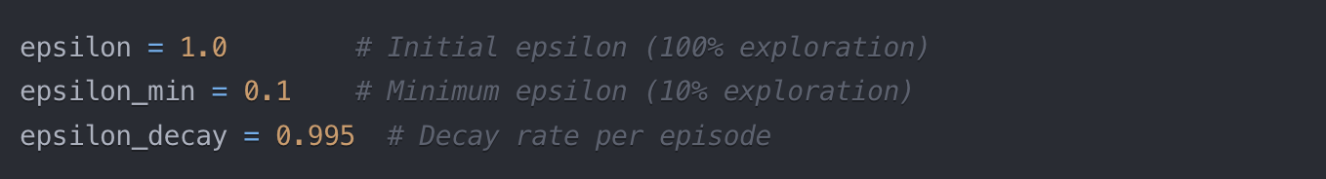
Epsilon Decay: Balancing Exploration and Exploitation
Understanding Epsilon Decay Strategy
Epsilon (ε): Probability of choosing a random action
Range: 0 ≤ ε ≤ 1
High ε: More exploration (random actions)
Low ε: More exploitation (best known actions)
Purpose:
Start with full exploration
Gradually shift to exploitation
Maintain minimum exploration

Slide 9
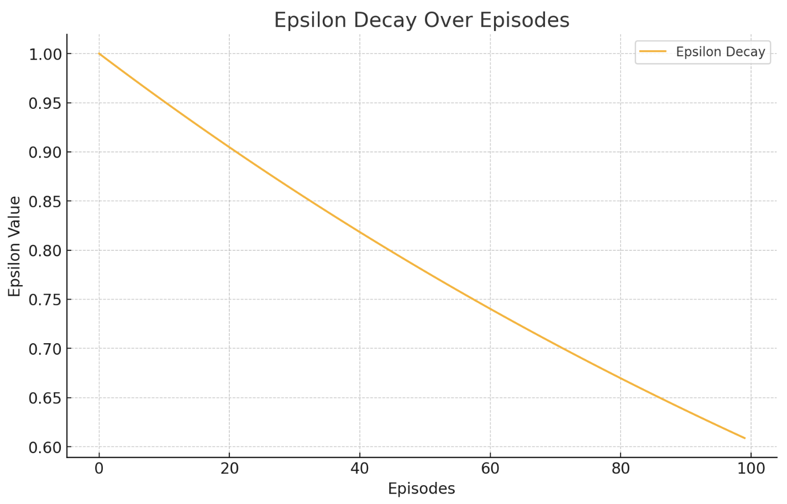

The Mechanics of Epsilon Decay
How Epsilon Decay Works
Initial Stage:
ε = 1.0 (100% random actions)
Agent explores environment freely
2. Decay Process:
After each episode: ε = ε * decay_rate
Decay formula in code:
3. Long-Term Behavior:
ε approaches minimum value (0.1 in our case)
Mostly exploitation with occasional exploration

Slide 10
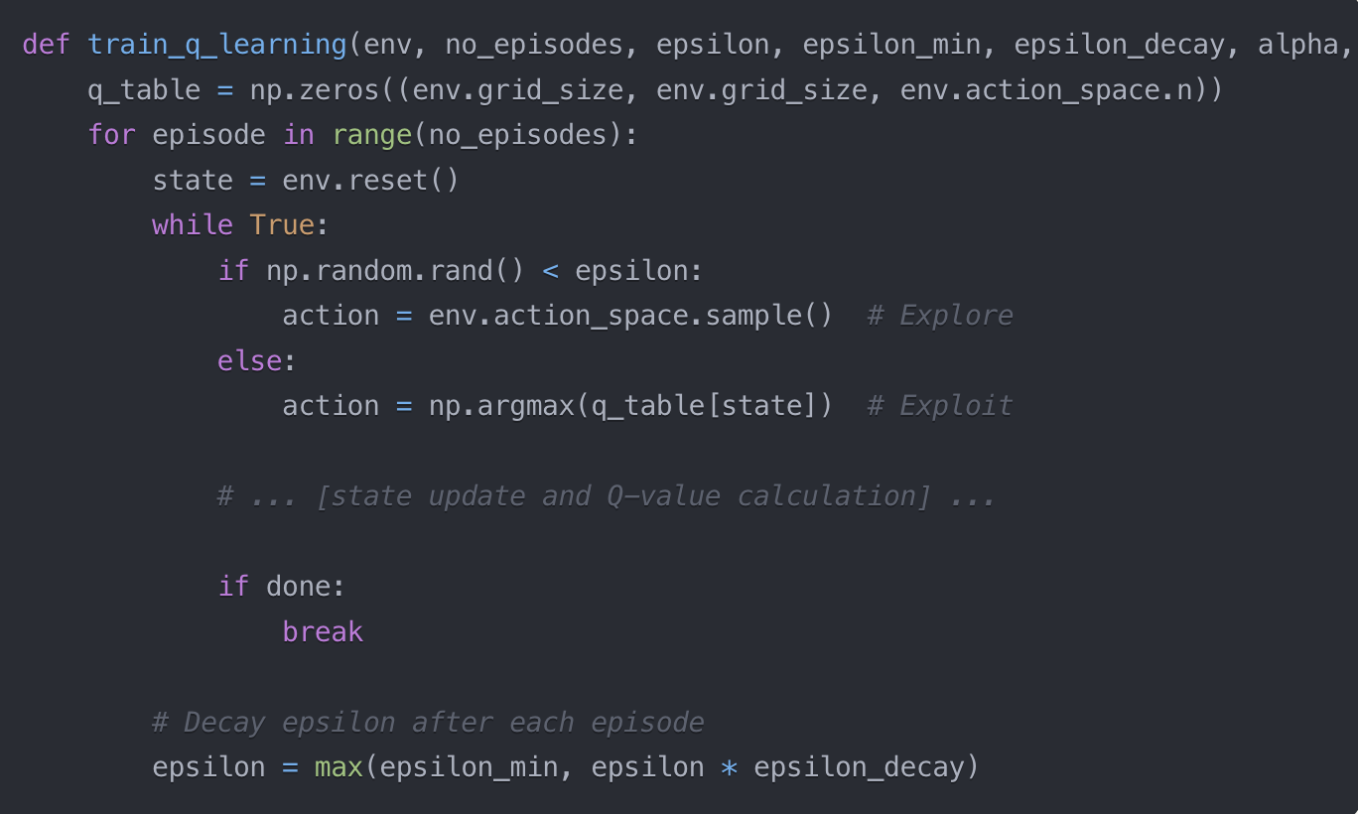
Epsilon Decay in Our Q-Learning Algorithm
Implementing Epsilon Decay in Q-Learning
Key Points:
Epsilon used in action selection (explore vs exploit)
Decayed after each complete episode
Ensures gradual transition from exploration to exploitation

Slide 11
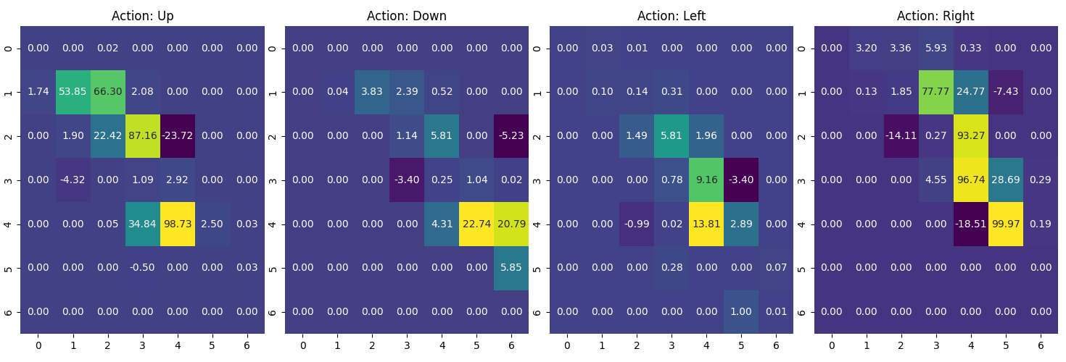
Q - Table
After 1000 episodes

Slide 12
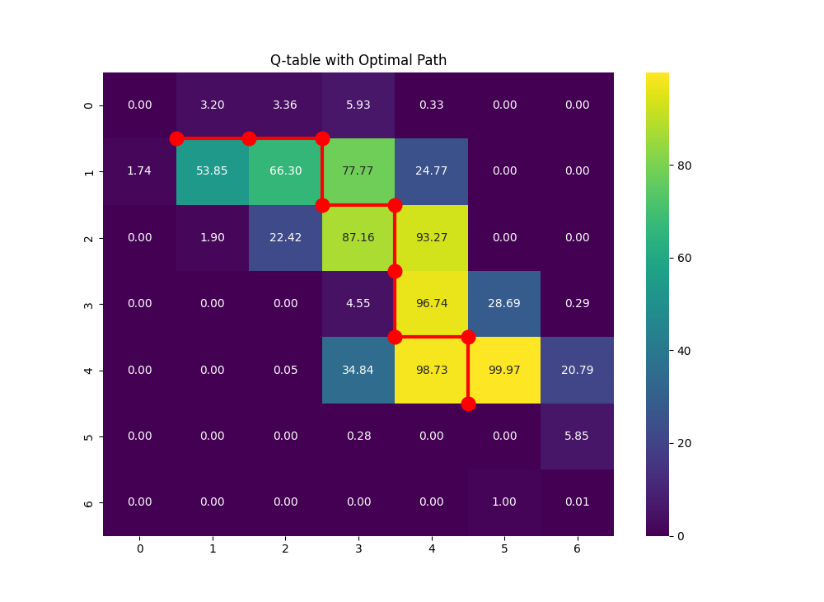
Q – Table with Optimal Path
After 1000 episodes

